Slide 1
Efficient Parameter Optimization for Compact Language Models
Youngjun yu
Department of Computer Science and Engineering

Slide 2





Motivation & Goal
Large language models (LLMs) with massive parameters demand extensive computational resources.
Existing lightweight models that reduce parameters suffer from degraded performance.
This research aims to design a compact language model that optimizes parameter efficiency through several techniques.
⇓

Slide 3
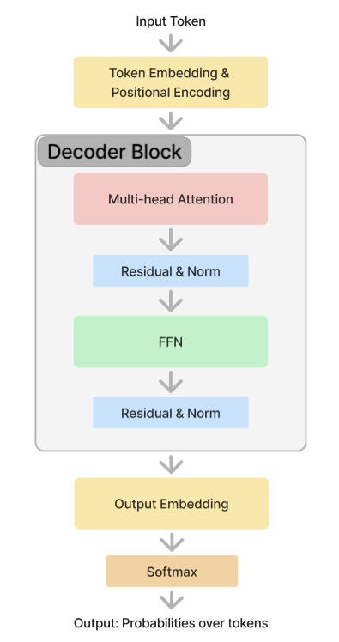
Baseline Model
Using the GPT-2 decoder-only model as the baseline and following the basic architecture of MobileLLM, a new model was developed.
To optimize the model's size, the following techniques were sequentially incorporated into its design.

Slide 4
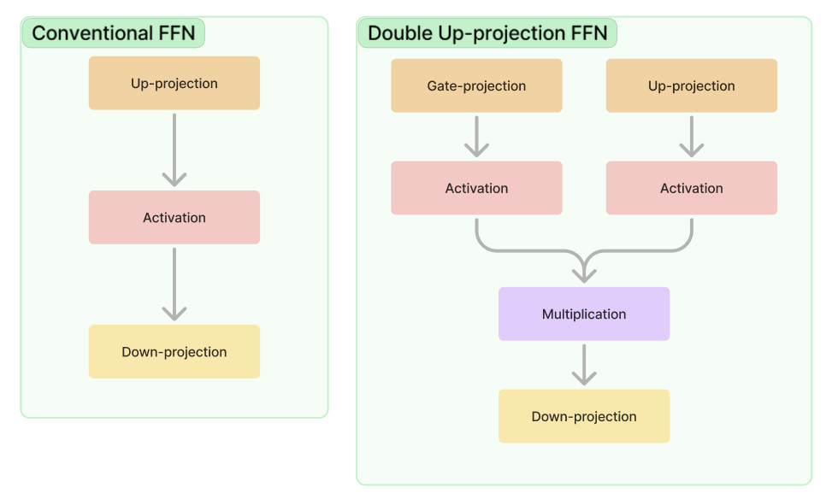
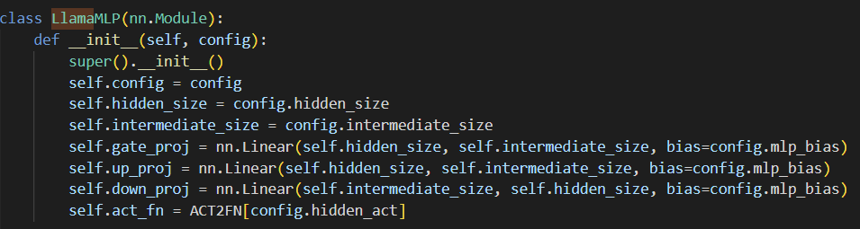
Double Up-Projection
A method was applied that involves two up_projections, gate_projection and up_projection, combined through element-wise multiplication.

Slide 5
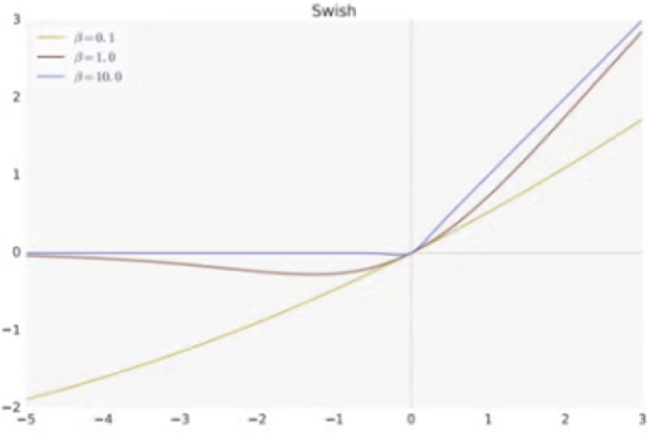

SwiGLU Activation Function
We used SwiGLU activation function in FFN instead of ReLU, which is known to be beneficial for small models.

Slide 6
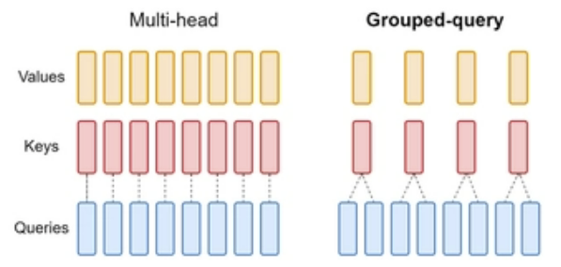
GQA (Grouped-Query Attention)
We applied GQA, which maintains the same number of queries while sharing a single key-value head across multiple queries.
To keep the total number of parameters consistent, we compensated for the reduction in parameters from GQA by increasing the number of decoder blocks or expanding the embedding dimension.

Slide 7
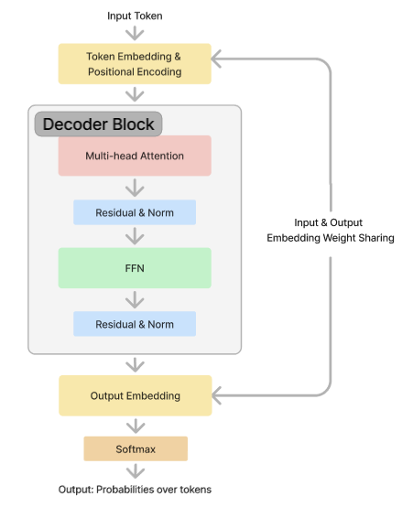
Embedding Sharing
The parameters of the embedding layer, which maps the input tokens (vocabulary size → embedding dimension), were reused as the parameters of the output embedding layer (embedding dimension → vocabulary size).

Slide 8
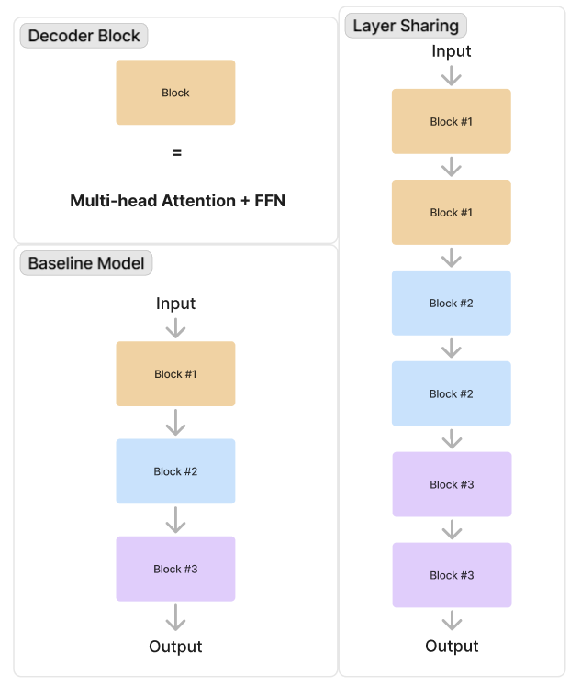
Layer Sharing
We employed the Layer Sharing technique, where the same parameters are shared and each decoder block is repeated twice in sequence.
This approach enhanced performance while maintaining the same number of parameters.

Slide 9
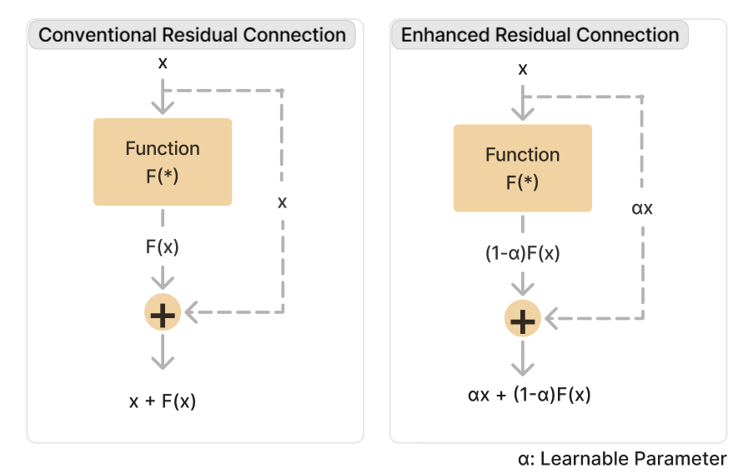
Enhanced Residual Connection
The Enhanced Residual takes the form 𝛼⋅𝑥+(1−𝛼)⋅𝐹(𝑥), where 𝛼 is a learnable parameter set between 0 and 1.
This approach assigns weights to 𝑥 (the input) and 𝐹(𝑥) (the function) based on their relative importance and combines them accordingly.

Slide 10
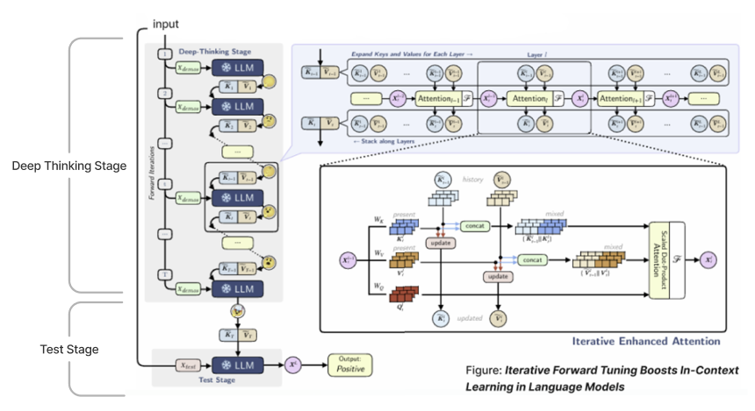
Deep Thinking

Slide 11

Deep Thinking
During the deep thinking stage, the model undergoes a total of T forward passes, repeatedly updating the key-value matrix.

Slide 12

Deep Thinking
The accumulated key and value matrices up to that point are concatenated, followed by passing through the attention and FFN to produce the output of the current layer.

Slide 13

Deep Thinking
The previously accumulated keys and values are combined with the keys and values generated by the current layer to produce updated keys and values that incorporate the information from the current layer.

Slide 14
Experimental Settings & Model Details
We conducted training and evaluation on the following four models.
Baseline Model
Layer Sharing Model
Baseline Model + Double Up-Projection, SwiGLU, Embedding Sharing, GQA, Layer Sharing
Enhanced Residual Model
Layer Sharing Model + Enhanced Residual Connection
Deep Thinking Model
Enhanced Residual Model + Deep Thinking

Slide 15
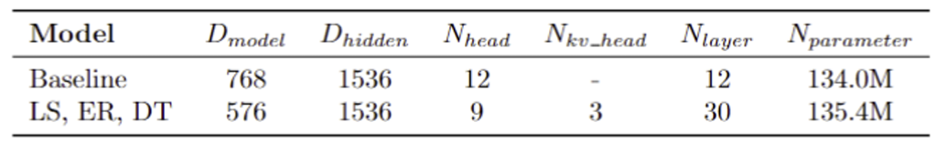
Experimental Settings & Model Details
The models were trained on the Wikitext-103 dataset, and their performance was evaluated using perplexity on this dataset.
For training, we used the Adam optimizer with an initial learning rate of 2e-3 and a weight decay of 0.1. The batch size was set to 4, and the training was conducted on a TitanXP GPU.
In the Deep Thinking model, the number of deep thinking steps (𝑇) was set to 3, and the 𝜂 used for KV-memory updates was set to 0.01.

Slide 16

Main Results
The perplexity of the four models on the Wikitext dataset is as follows.
Perplexity represents the average uncertainty of the probability distribution predicted by the model, with lower values indicating better performance.
The performance improved gradually as each technique was added to the baseline model, and applying Deep Thinking led to a significant performance boost.

Slide 17
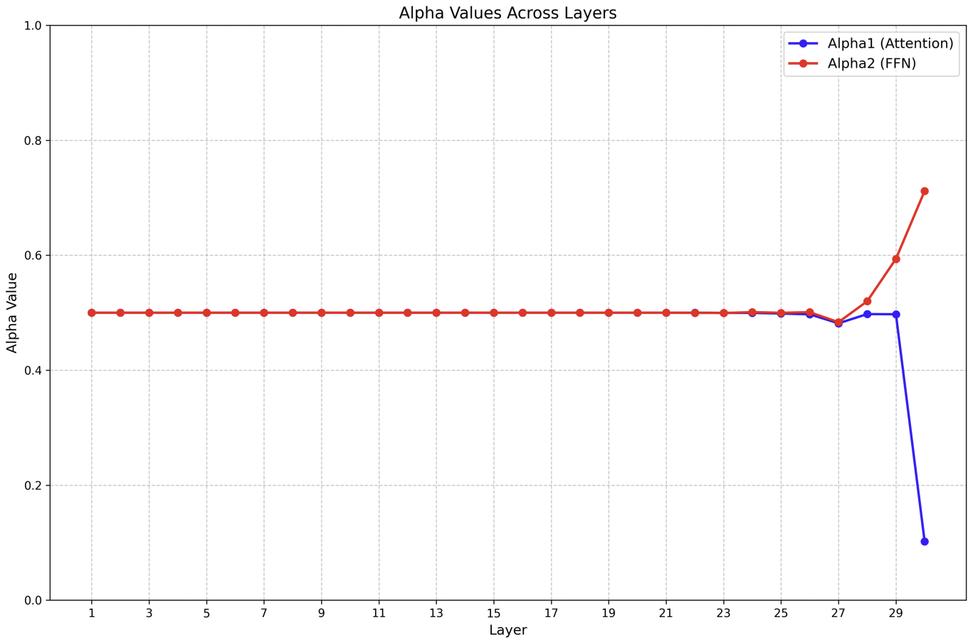
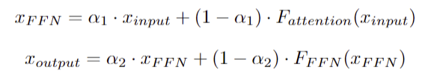
Main Results
When Enhanced Residual was applied, the plot of alpha values for each layer is as follows.
A large alpha value indicates a greater weight on the input 𝑥 before applying the function 𝐹, while a smaller alpha value indicates a greater weight on the output of the function 𝐹(𝑥).

Slide 18
Discussion
Both 𝛼1​ and 𝛼2 assigned equal weights to 𝑥 and 𝐹(𝑥) from layers 1 to 26, but differences emerged in layers 27 to 30.
Specifically, 𝛼1 decreased, placing greater weight on the value after attention, while 𝛼2 increased, giving greater weight to the value before the FFN.

Slide 19
Discussion - 𝛼1 (Attention)
In the later layers (27–30), the output is about to be generated, requiring greater focus on the newly integrated contextual information (the value after attention).
This can be interpreted as the reason for the decrease in 𝛼1, giving more weight to this value.

Slide 20
Discussion - 𝛼2 (FFN)
The later layers (27–30) should focus on refinement rather than significantly modifying the representation. Therefore, the non-linear transformation of the FFN may become less necessary in the later layers.
Consequently, the weight on the values after the FFN decreases, which can be interpreted as the increase in 𝛼2.

Slide 21
Future Work
The Deep Thinking approach used in the model significantly improves performance but also increases inference time due to multiple Deep Thinking stages during inference.
This trade-off is particularly critical as it conflicts with the goal of creating a compact language model.
Therefore, future research will aim to optimize inference time by dynamically adjusting the number of thinking stages based on the complexity of the input, rather than applying the same number of stages to all inputs.

